Slide 1

TUMOR DETECTION USING DIGITAL IMAGE PROCESSING
Submitted by:
Benny Aman 205873599
Sapir Seluk 308308980
28.02.21
Lecturer – Doctor Asher Perez

Slide 2
PROJECT IDEA
Detection a tumor in the tissue using demarcation boundaries by MRI method with MATLAB

Slide 3
CONTENTS
OBJECTIVE
INTRODUCTION
METHODOLOGY
RESULTS
CONCLUSION
BIBLIOGRAPHY

Slide 4
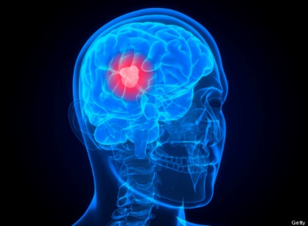
OBJECTIVE
To detect the tumor and location of brain tumors from the Magnetic Resonance Images using Digital Image Processing.

Slide 5
INTRODUCTION
Brain tumor is an abnormal mass of tissue in which cells grow and multiply uncontrollably seemingly unchecked by the mechanisms that control normal cells.
Brain tumor can primary and metastatic, also can be benign or malignant.
Primary brain tumors include any tumor that start within the brain also it affect the membrane around the brain, nerves or glands.
To identify a tumor a patient has to undergo several test but the commonly used test include CT scan, MRI scan, PET scan etc.

Slide 6
MRI
MRI is used to locate or visualize internal structure of the body in detail. From this detailed anatomical information is collected to examine the human brain development and discover the abnormalities.
How does it work?
The body is largely composed of water molecules.
Each water molecule has two hydrogen nuclei or protons
A powerful magnetic field causes the magnetic moments of some of these protons to align with the direction of the field.
The protons in different tissues return to their equilibrium state at different rates

Slide 7
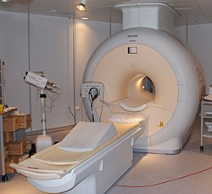
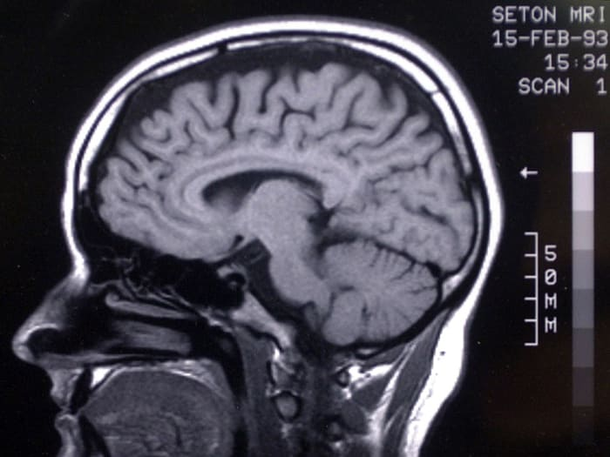
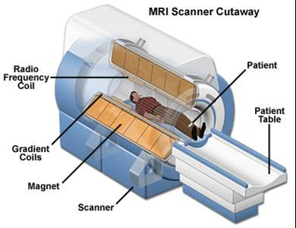
Conti…..MRI

Slide 8
Methodology
MRI SCAN
PRE-PROCESSING
Gray Scale Image
POST PROCESSING
TOMUR OUTPUT
Image Filtering
Segmentation
Morphological Operations

Slide 9
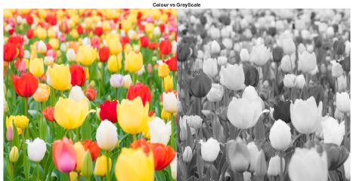
Grayscale Imaging
Gray scale imaging is called as black and white image and it can also be called as halftone image so obtained by considering the images as a grid of black dots on white background.
Also because there are 8 bits in binary representation of the gray level , so this method is also called 8-bitgrayscale.also it can be used in the preprocessing step of image segmentation to improve upon the contrasted image

Slide 10
High Pass Filter
High pass filter is used to do the sharpening of the images to the grayscale images. Sharpening is used to get the fine details of the image highlighted. Also it is used for edge detection.
These filters sharpens images by creating a high contrast overlay that emphasis edge in the image ,so also we can say that enhanced image is the result of addition of original image and the scaled version of the line structure and edges in the image.
High pass filter is also used to retain the frequency information within the image.

Slide 11
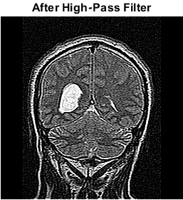
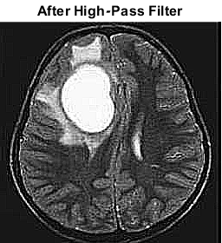
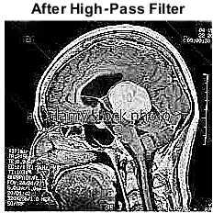
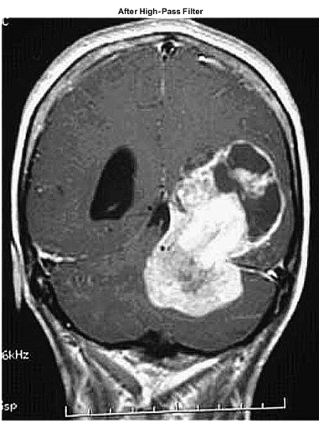
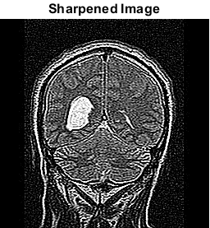

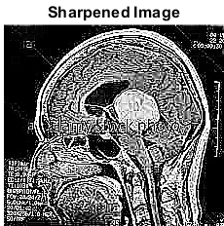
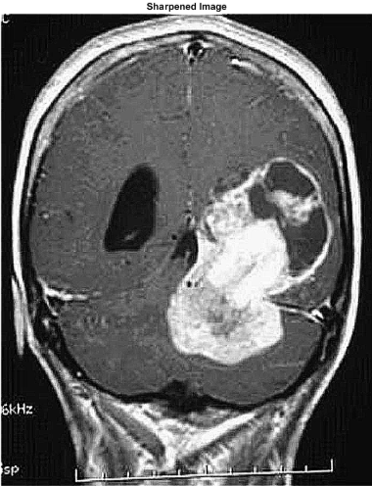
Results for High Pass Filter

Slide 12
Noise remove using median filter
Digital images are prone to various types of noise. Noise is the result of errors in the image acquisition process that result in pixel values that do not reflect the true intensities of the real scene. There are several ways that noise can be introduced into an image, depending on how the image is created.
These type of filtering set the value of the output pixel to the average of the pixel values in the neighborhood around the corresponding input pixel. With median filtering, the value of an output pixel is determined by the median of the neighborhood pixels, rather than the mean. Median filtering is therefore better able to remove these outliers without reducing the sharpness of the image.

Slide 13
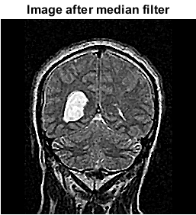
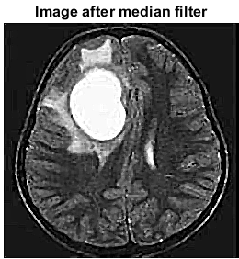
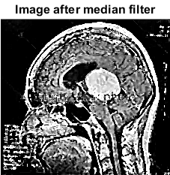
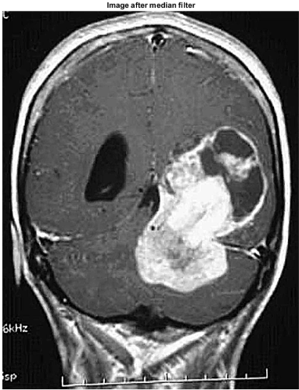
Results

Slide 14
Threshold Segmentation
Segmentation is the process of partitioning the images into multiple segments.(set of pixels).
Image segmentation is typically used to locate the objects and boundaries(lines, curves) in the images also we can say assigning the label to each pixels in an image such that pixels share same label to view the visual characteristics.
Threshold method is based on the threshold value to turn a grayscale image into a binary image.

Slide 15

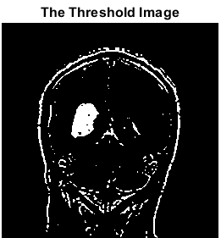
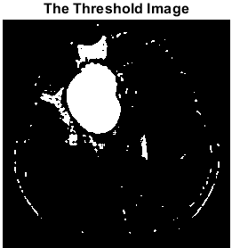
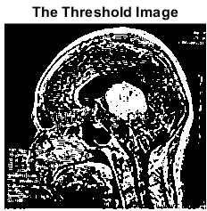
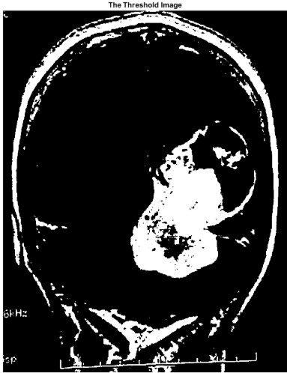
Conti… Threshold Segmentation
Thresholding is the simplest technique of image segmentation which is used to create binary images from grayscale images, morphological operation is used to check and determine the size and shape of tumor whereas image subtraction is applied to extract tumor region

Slide 16
Morphological Operation
Morphology refers to the description of the properties of the shape and structure of the objects. Here binary images consists of various imperfections Thresholding are distorted by the noise and texture features.
Morphological operations are logical transformation based on the comparisons of the pixel neighborhood with a pattern.
These operations are usually performed on the binary images where the pixels values is between 0 and 1.

Slide 17
Conti… Morphological Operation
Morphological operations have proved very helpful in extraction and filtering techniques where operators like open, spur, dilate, erode and close have proved to be helpful in extracting the brain tumor from MRI brain images.
Image subtraction technique proved to be helpful along with threshold segmentation to work for the desired region of the image.

Slide 18
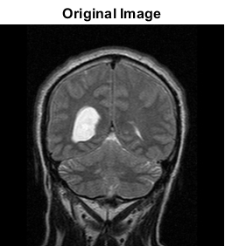
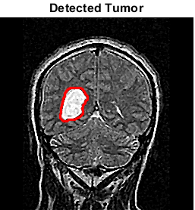
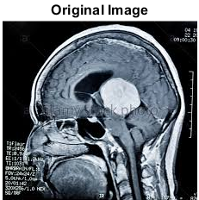
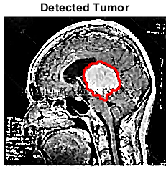
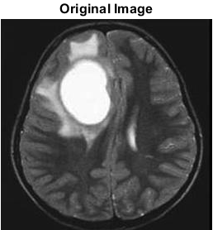
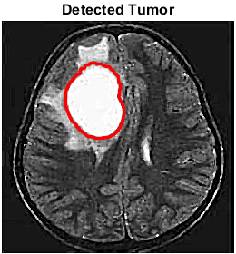
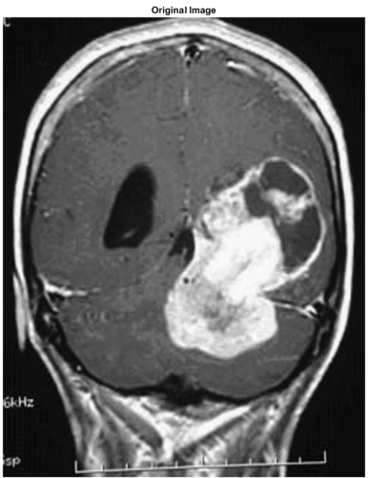
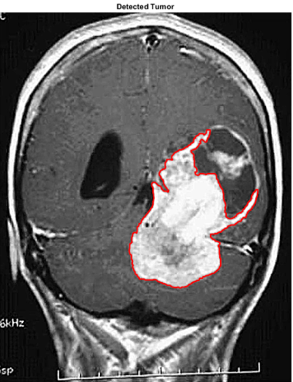
Results

Slide 19
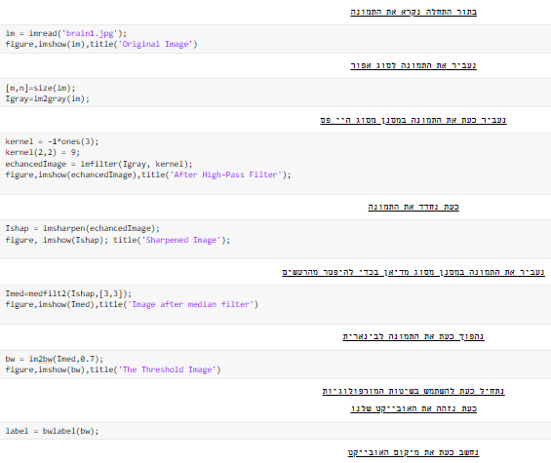
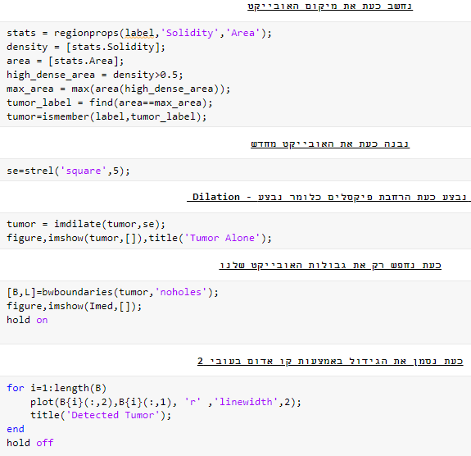
Our Code

Slide 20
Conclusion
The current method uses a computer aided system for brain MRI image segmentation for detection of tumour location using bounding box symmetry.
The resulting method is very fast, robust and reliable for indexing tumour or edema images for both archival and retrieval purposes and it can use as a vehicle for further clinical investigations.

Slide 21
Bibliography
Digital image processing by Gonzalez, Rafael C. Woods, Richard E.
Digital Image Processing Using MATLAB by Rafael C. Gonzalez, Richard E. Woods, Steven L. Eddins
Course presentations
https://en.wikipedia.org/wiki/Magnetic_resonance_imaging
https://www.mathworks.com/discovery/image-thresholding.html
https://en.wikipedia.org/wiki/Thresholding_(image_processing)
https://www.mathworks.com/help/images/morphological-dilation-and-erosion.html
https://www.mathworks.com/help/images/noise-removal.html

Slide 22


